Slide 1
XML3DRepo: A REST API for Version Controlled 3D Assets on the Web Doboš, Sons, Rubinstein, Slusallek, Steed
Notes:
DFKI - the German Research Center for Artificial Intelligence
VEIV – UCL Engineering Doctorate Training Centre in Virtual Environments, Imaging & Visualisation

Slide 2
Introduction
XML3D
REST
3D Repo
XML3DRepo

Slide 4
Motivations
Make 3D as ubiquitous as images/video
Serve file format independent 3D assets
Create a scalable open platform for 3D content creation on the web
Provide dedicated version control

Slide 5
Introduction
XML3D [Sons et al. ‘10]
Extension to HTML5
Modifiable via JavaScript
http://xml3d.org
3D Repo [Doboš & Steed ‘12]
Domain specific version control framework
NoSQL DB with Binary JSON storage/queries
http://3drepo.org

Slide 6
REST
[Fielding ‘00]
Defines resources & responses
Maps HTTP 1.1 verbs to CRUD functions
Hence requires only location & action
POST | GET | PUT | DELETE
create | read | update | delete

Slide 7
Contributions
Taxonomy
Implementation
Evaluation
API
Unifying XML3D and 3D Repo
3D data delivery strategies
http://xml3drepo.org
In terms of speed and efficiency
REST architecture
6 distinct encodings
Discussion of implications
Detailed example descriptions

Slide 8
Related Work
[Schiefer et al. ‘10] – OpenSG
[Olbrich ‘12] – XHR on X3D, NoSQL DB
[Schubotz & Harth ‘12] – XML3D internal refs
Rest3D – XML, JSON
Sunglass.io – binary file, JSON
Notes:
Schiefer et al. ’10. Service-oriented scene graph manipulation. Web3D ’10
Olbrich ‘12. Accessing http interfaces within x3d script nodes. Web3D ’12
Schubotz & Harth ‘12. Towards networked linked data-driven web3d applications. In Dec3D, CEUR-WS.org, vol. 869 of CEUR Workshop Proceedings.
Parisi, T., & Arnaud, Rest3D 2011

Slide 9
System Overview
Client
Database
Server
Request
Query
Resource
Response
Notes:
XML3D client in a web browser sends a request to a REST server which queries a database running 3D Repo. The DB returns a response to the server which encodes the data into a suitable representation and returns it to the client as a resource.

Slide 10
XML3D
HTML5 extension
<data> element
Recursive referencing
Fine-grained control over scene composition
Xflow
Adds a declarative dataflow component
Reference operator to compute output
Similar to X3DOM (based on X3D/VRML97)
Notes:
The Inline node of the VRML/X3D for external documents can include only complete subscenes.

Slide 11
XML3D Referencing
XML3D Doc
<data id=“A”>
#A
<mesh>
Extern.xml
Extern.xml#A
Extern.json
Extern.json
<data id=“A”>
{“data”:{ “index”:{ ... }
<data id=“B”>

Slide 12
3D Repo
Non-linear versioning framework
Interactive 3D Diff tool
Stored in a NoSQL database
Scene graph
Revision history
Each node carries
Unique identifier (UID)
Shared identifier (SID)
Notes:
Non-linear versioning of 3D assets including meshes, materials, textures etc.

Slide 13
XML3DRepo REST API
Decouples storage from data delivery
Characterized by two-way URI encoding
/:id/:type
/:type/:id
id is the UID or SID depending on context
type is any family of resources: ‘meshes’, ‘textures’, ‘revisions’, …

Slide 14
POST
Create new repositories
Commit changes
Create/merge branches
/xml3drepo
/xml3drepo/:name
/xml3drepo/:name/:id

Slide 15
GET
Retrieve
Collections
Resources
Single resources
Individual attributes
/xml3drepo/:name/:id/:type
/xml3drepo/:name/:type/:id
/xml3drepo/:name/:type/:id/:attribute

Slide 16
HEAD
Same as GET
Without body of the resource
For accessing DAG structure
Scene graph
Revision history

Slide 17
PUT
Idempotent
Updating in place not suitable for versioning
Can request changes in the state (e.g. locking)
Not supported in most existing APIs
/xml3drepo/:name/:id/:type
/xml3drepo/:name/:type/:id
Notes:
Commits new revision identified by the type to a branch identified by its shared ID. If the type is ‘locks’, acquires a lock on the branch.
Commits a new revision of a resource identified by its UID or SID to the trunk/master. If the UID is not at its head revision, the request fails with a conflict. If the type is ‘locks’, acquires a lock on the resource.

Slide 18
DELETE
Missing in some web browsers
Versioning does not actually delete nodes
Preferred to commit deletes as one revision
/xml3drepo/:name
/xml3drepo/:name/:id/:type
/xml3drepo/:name/:type/:id
Notes:
Commits new revision identified by the type to a branch identified by its shared ID. If the type is ‘locks’, acquires a lock on the branch.
Commits a new revision of a resource identified by its UID or SID to the trunk/master. If the UID is not at its head revision, the request fails with a conflict. If the type is ‘locks’, acquires a lock on the resource.

Slide 19
3D Web Formats Taxonomy
3D
Text
Binary
Data
X3D
JSON
XML
Unstructured
glTF
XML3D
Multi-purpose
XMI
FastInfoset
BSON
3D Specific
Document
File Formats
OpenCTM
Webgl-loader
Image Geometry
SIG

Slide 20
3D Web Formats Taxonomy
3D
Text
Binary
Data
X3D
JSON
XML
Unstructured
glTF
XML3D
Multi-purpose
XMI
FastInfoset
BSON
3D Specific
Document
File Formats
OpenCTM
Webgl-loader
Image Geometry
SIG
Require parsing
Large size
Deserialization to TypedArrays
Compress well
Human-readable
DOM access at parse time
Notes:
Documents can reference external resources
XML - CSS Selectors and XPath
JSON - no addressing possible

Slide 21
3D Web Formats Taxonomy
3D
Text
Binary
Data
X3D
JSON
XML
Unstructured
glTF
XML3D
Multi-purpose
XMI
FastInfoset
BSON
3D Specific
Document
File Formats
OpenCTM
Webgl-loader
Image Geometry
SIG
No structure
Direct data access
Many XHR requests degrade performance
Interleaving of attributes
Notes:
Array buffer introduced with Typed Arrays, essentially a byte array (Uint16Array, Float32Array)
XMLHttpRequest (XHR)
glTF - the runtime asset draft specification format for WebGL, OpenGL ES, and OpenGL
Transmitted via XHR as ArrayBuffer. View generated and Typed Array derived. No structure, hence one buffer per attribute.

Slide 22
3D Web Formats Taxonomy
3D
Text
Binary
Data
X3D
JSON
XML
Unstructured
glTF
XML3D
Multi-purpose
XMI
FastInfoset
BSON
3D Specific
Document
File Formats
OpenCTM
Webgl-loader
Image Geometry
SIG
Competing standards
Generic encodings
Missing JS implementation
Significant compression*
Notes:
There are several competing standards for binary encoded XML, for instance XML Metadata
Interchange (XMI) and FastInfoset (FI)
Structured data, e.g. binary XML
Exploit various compression methods
Binary JSON – extends JSON data types

Slide 23
3D Web Formats Taxonomy
3D
Text
Binary
Data
X3D
JSON
XML
Unstructured
glTF
XML3D
Multi-purpose
XMI
FastInfoset
BSON
3D Specific
Document
File Formats
OpenCTM
Webgl-loader
Image Geometry
SIG
Not compatible with Typed Arrays
Existing JS implementation
Slow decoding
Some compression
Notes:
OpenCTM, webgl-loader
Domain specific schema
Slow JavaScript-based decoding
Processing blocks UI thread

Slide 24
3D Web Formats Taxonomy
3D
Text
Binary
Data
X3D
JSON
XML
Unstructured
glTF
XML3D
Multi-purpose
XMI
FastInfoset
BSON
3D Specific
Document
File Formats
OpenCTM
Webgl-loader
Image Geometry
SIG
Fetching in vertex shader
Direct GPU upload
Low compression
Quantization
Notes:
Images decoded directly in the browser core
Can split data into 8-bit chunks
Progressive loading if arrive in order

Slide 25
Implementation
node.js server & XML3D client
JavaScript port of 3D Repo C++ client
UID and SID as universally unique ID (UUID)
Polyfill version of XML3D [Sons et al. ’13]
Custom loaders
Caching based on UID and encoding format

Slide 26
Loaders
XML – native parsing
JSON – native parsing
BSON – custom decoder
OpenCTM – existing JavaScript decoder
SIG – mesh node -> Xflow -> images
ArrayBuffers – similarly to Binary Geometry [Behr et al. ‘12]

Slide 27
Experimental Setup
Chrome, Firefox and Opera on Win 7
Browser caching disabled
Intel Xeon server with node.js and MongoDB
All SIG encodings with 8-bits per normal
3 game levels
Textures excluded
5 trials per encoding per browser per scene

Slide 28
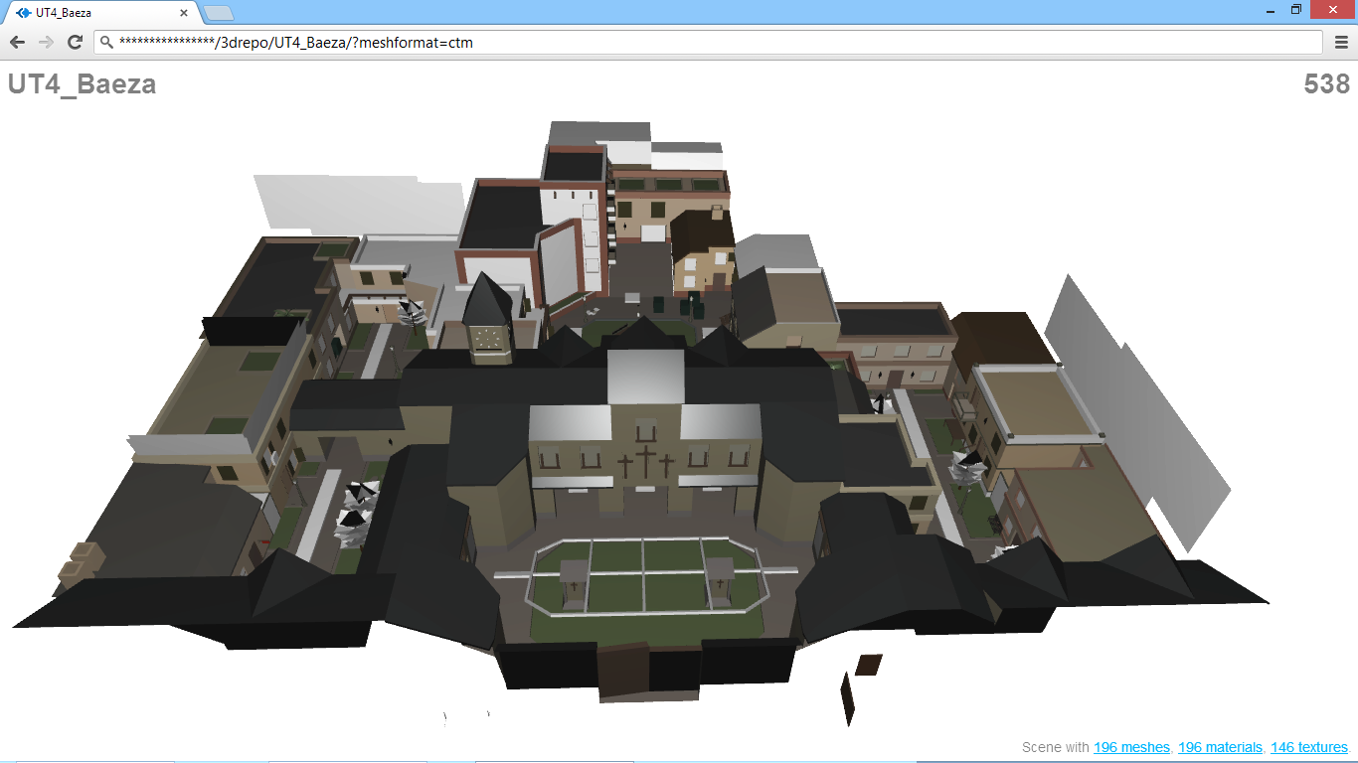
UT4 Baeza
Notes:
UT4 Baeza with over 93k vertices, 31k faces and 196 meshes

Slide 29
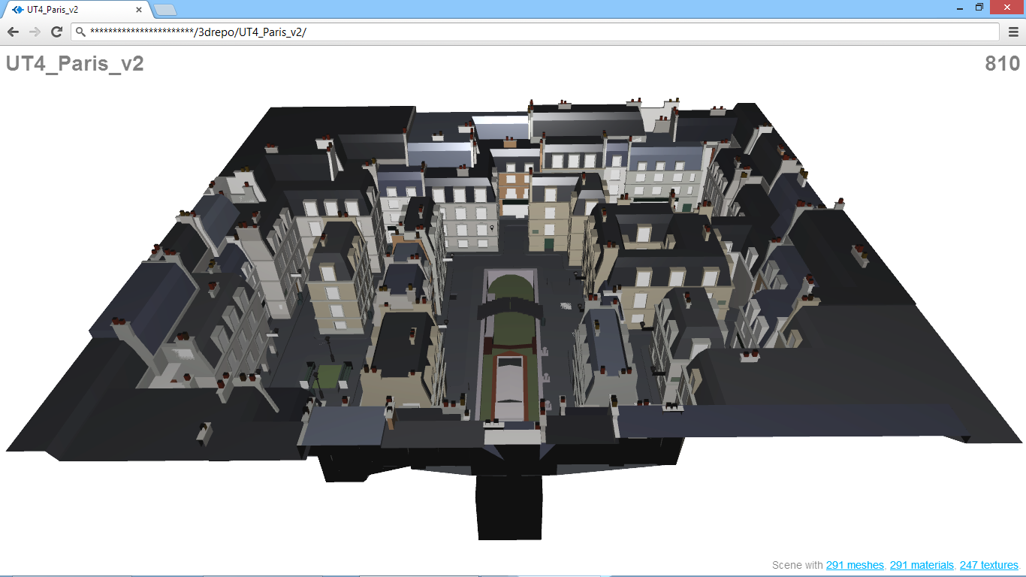
UT4 Paris v2
Notes:
UT4 Paris v2 with over 129k vertices, 43k faces and 291 meshes

Slide 30
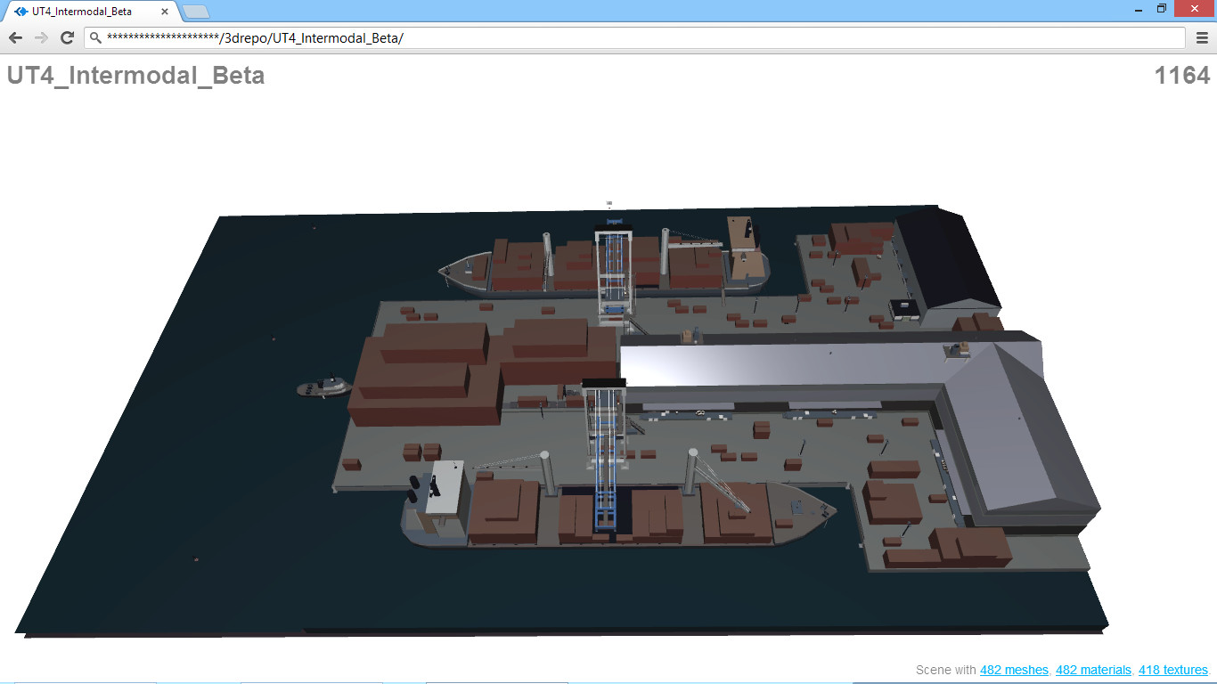
UT4 Intermodal Beta
Notes:
UT4 Intermodal Beta with over 170k vertices, 56k faces and 482 meshes

Slide 31
Overall Download Size (UT4 IB)
Raw [MB]
Gzip
[MB]
Requests
XML
11.9
2.4
980
JSON
11.9
2.3
980
BSON
15.7
4.6
980
SIG 8
-
bit
2.5
1.7
1944
SIG
16
-
bit
3.2
2.4
2908
SIG
24
-
bit
3.9
3.3
3872
SIG 32
-
bit
4.8
4.0
4836
OpenCTM
2.1
1.3
980
ArrayBuffers
5.9
4.0
2908
Notes:
Overall download size of uncompressed (Raw) vs. compressed (Gzip) encodings in MB and the total number of requests for the largest scene (170k vertices, 56k faces). Values for the other models can be found in the paper and supplemental materials.

Slide 32
Overall Timings (UT4 IB)

Slide 33
Overall Timings (UT4 IB)

Slide 34
Discussion
Compressed data timings are very similar
Many HTTP requests hamper download time
SIG 32 not shaded although data transmitted
Best encoding depends on
Network connection
Client performance
Application needs
Client can choose the desired format

Slide 35
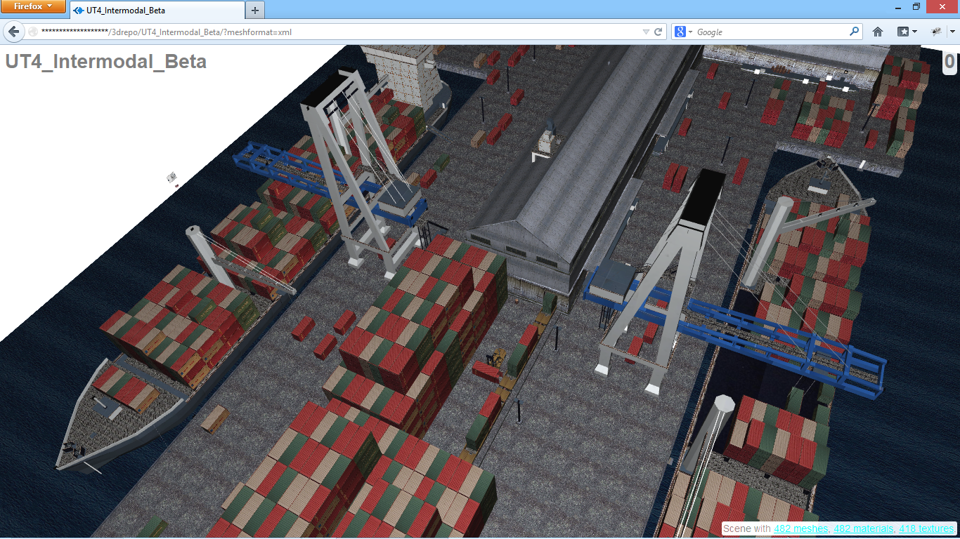
XML3DRepo on Windows
Notes:
Urban Terror 4 game level Intermodal Beta with 170k vertices and 418 textures is version controlled in 3D Repo and accessed as XML3D using our REST API in a Firefox web browser on Windows 8. XML3DRepo architecture delivers requested data in the format most suitable for the current device and network, for instance, using Sequential Image Geometry for devices that support texture fetching in the vertex shader or OpenCTM for networks with low bandwidth. Model courtesy of Snipers Gaulois CTF Clan.

Slide 36
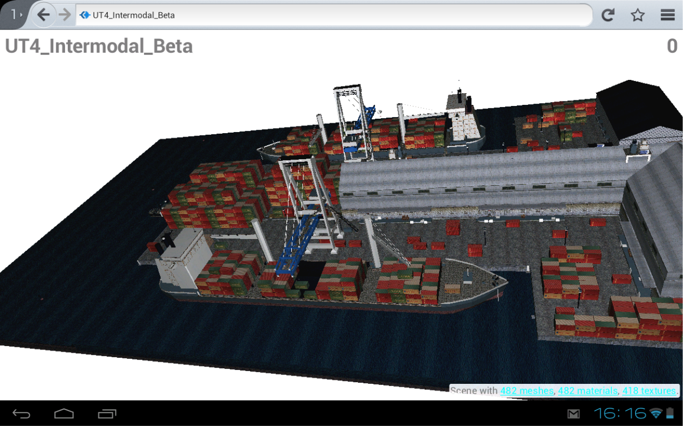
XML3DRepo on Android

Slide 37
Conclusions
Data stored as BSON independent of XML3D
Export in a variety of encodings
Visual feedback via progressive loading
XML3D works well with external referencing
Abilities beyond simple file server
Retrieve scenes, components and even attributes
Advanced search
No single encoding fits all

Slide 38
Future Work
Build into a robust platform shared by the community
Distributed access
Automated encoding selection
Include proximity and semantic queries
Define a more suitable 3D delivery format
Investigate data compression on upload
Notes:
Holy grail search: One option based on Typed Arrays and provide a domain-specific compression using Xflow

Slide 39
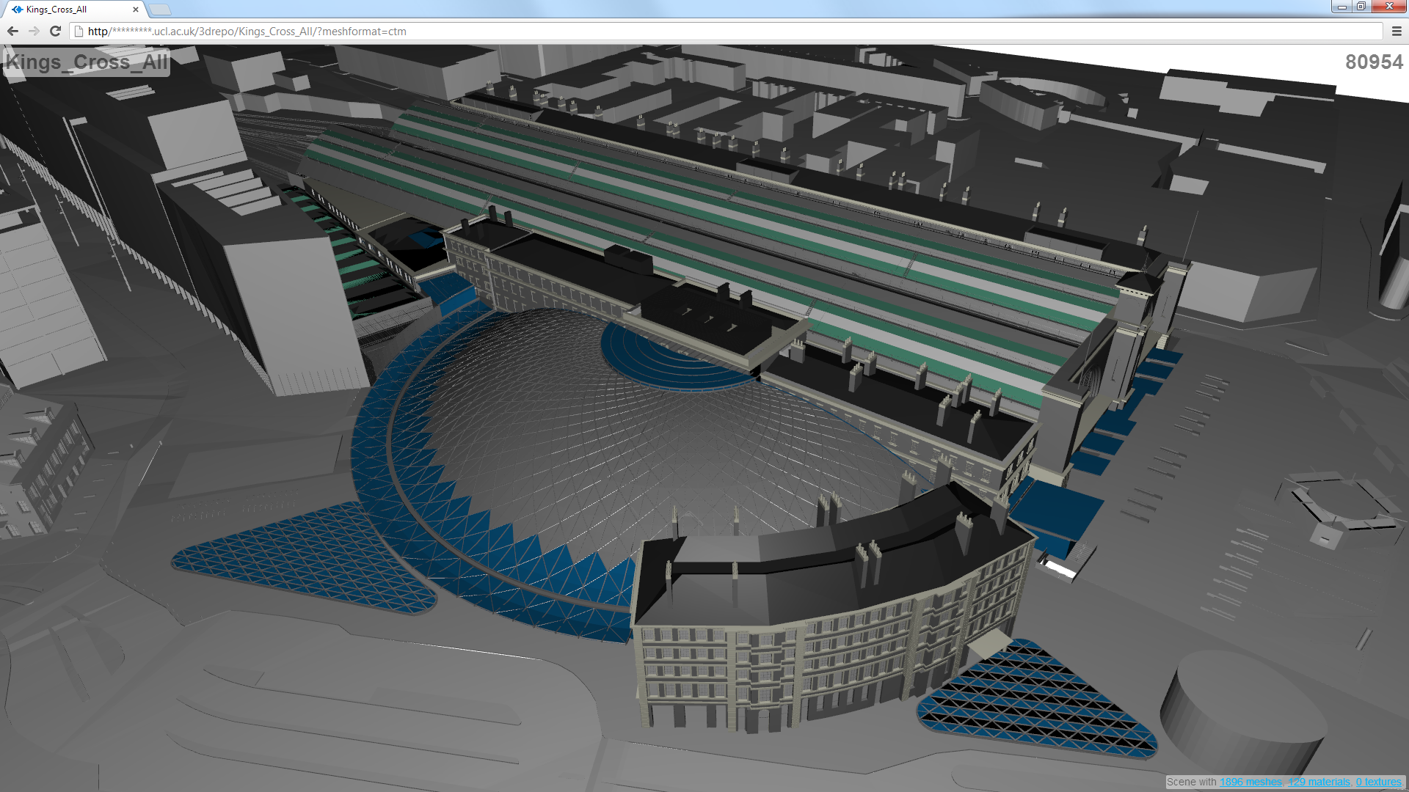
The Future of Experiential Design and Stakeholder Engagement on the Web
Room B at 12:00

Slide 40
Sponsors
VERVE Consortium http://verveconsortium.eu
Arup Foresight & Innovation http://driversofchange.com
UK Engineering and Physical Sciences Research Council http://www.epsrc.ac.uk
FI-CONTENT http://fi-content.eu
Intel Visual Computing Institute http://www.intel-vci.uni-saarland.de

Slide 41
References
Behr, J., Jung, Y., Franke, T. & Strum, T. 2012. Using Images and Explicit Binary Container for Efficient and Incremental Delivery of Declarative 3D Scenes on the Web. Web3D ’12
Doboš, J. & Steed, A. 2012. 3D revision control framework. Web3D ‘12
Fielding, R. T. 2000. Architectural styles and the design of network-based software architectures. PhD thesis, University of California, Irvine.
Olbrich, M. 2012.Accessing http interfaces within x3d script nodes. Web3D ’12
Schiefer, A., Berndt, R., Ullrich, T., Settgast & V., Fellner, D. W. 2010. Service-oriented scene graph manipulation. Web3D ’10
Schubotz, R. & Harth, A. 2012. Towards networked linked data-driven web3d applications. In Dec3D, vol. 869 of CEUR Workshop Proceedings.
Sons, K., Klein, F., Rubinstein, D., Byelozyorov, S. & Slusallek, P. 2010. XML3D: Interactive 3D Graphics for the Web. Web3D ’10
Sons, K., Schlinkmann, C., Klein, F., Rubinstein, D. & Slusallek, P. 2013. xml3d.js: Architecture of a Polyfill Implementation of XML3D. In 6th Workshop on Software Engineering and Architectures for Realtime Interactive Systems.

